Slide 1

SCRUM

Slide 2

Introduction
A popular framework for project management.
Widely used in software development.

Slide 3

Key aspects
Three pillars
Transparency
Inspection
Adaptation

Slide 4




Three Roles
The framework is iterative with regular sprints and reviews.
Scrum Master
Development Team
Product Owner

Slide 5


Advantages & Disadvantages
Flexibility - Complexity
Team collaboration - Overhead
Regular feedback - Lack of clear goals

Slide 6


Competitors
Waterfall - linear, sequential approach (building a house)
Lean – creates value for customers while reducing waste (Cleaning a river)
Kanban – visual system for managing work (whiteboard to write tasks)

Slide 7
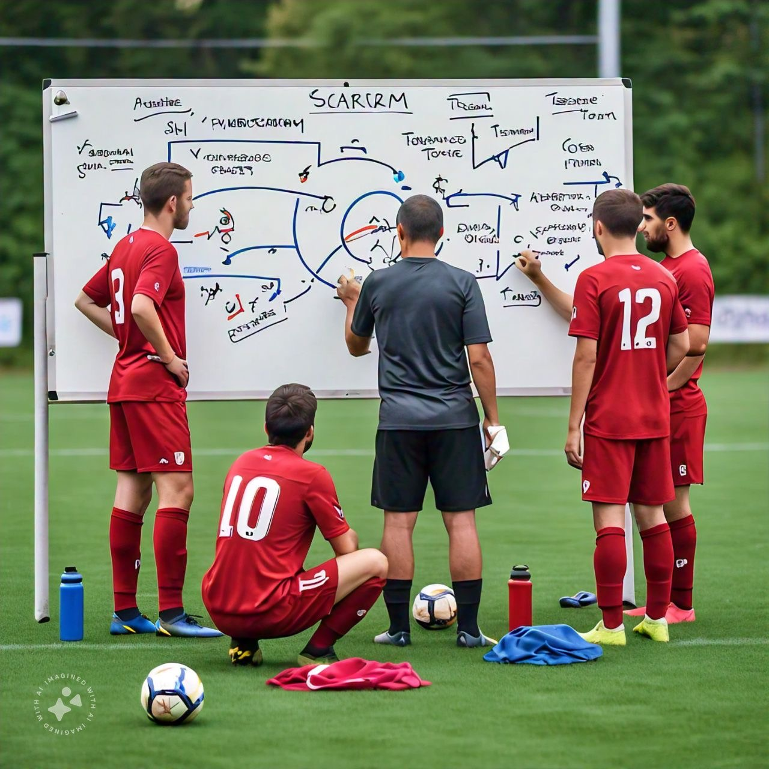


Non-IT example
Sports team (Soccer)

Slide 8




THANK YOU!
Boitumelo Shandu
boitu.ashandu@gmail.com
0790675255

